Slide 1
Mvideo
Financial Analysis
Authors:
An Alina
Skobolev Alexander
Smirnova Valeria

Slide 2
Information about the company, its strategy
Field of activity:
Russian retail of household appliances and electronics, online trading platform.
History of development:
2000 - the online store www.mvideo.ru was launched;
2004 - establish a new store format "hypermarket";
2007 - opening of the 100th store, the first IPO among the participants;
2010 - opening of the 200th store;
2012 - opening of the first store outside of Moscow;
2013 - opening of the 300th store;
2016 - the M.Mobile project was launched;
2018 - merger of M.Video with Eldorado.
It has 3 controls:
General Meeting of Shareholders
Board of Registration
CEO
Period of functionality: 1993 - present.
Strategy:
The core of the company's Strategy-2022 is the transition from an omnichannel approach to the ONE RETAIL model through the complete digitalization of the customer experience, erasing all boundaries between the retail environment and online and offline sales channels.
For now:
1,074 stores
279 cities of Russia
M.Video (M.Video-Eldorado Group) includes two brands: M.Video and Eldorado.

Slide 3
Brief description of the market
M-video is the market leader in electronic and household appliances in Russia with a 27% share. According to various sources, the entire Russian consumer electronics market is valued at more than $25 billion, with an average annual growth rate of 10% over the past five years. At the same time, in 2020 the market grew stronger - by 22%, due to increased demand from buyers.
Main competitors
DNS
Citylink
Svyaznoi
Revenue: 562 billion rubles
Profit: 24.9 billion rubles
Stores: over 2,200
Cities: over 1,000
Revenue: 500 million rubles
Profit: 36.8 billion rubles
Stores: more than 650 pcs.
Cities: more than 360
Revenue: 15 million rubles
Profit: 101 billion rubles
Stores: more than 2600 pcs.
Cities: more than 1100

Slide 4
Analysis of the balance sheet structure, the structure of the profit and loss statement

Slide 5
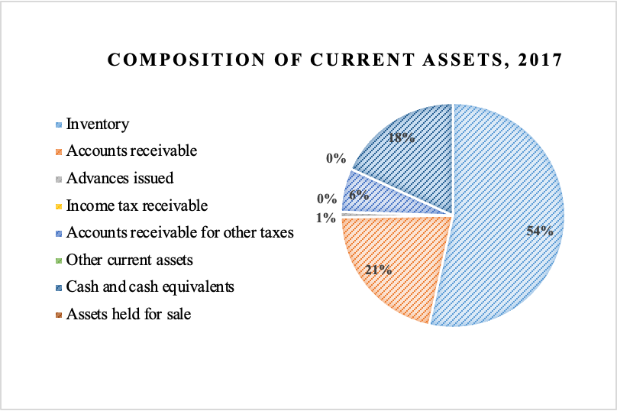
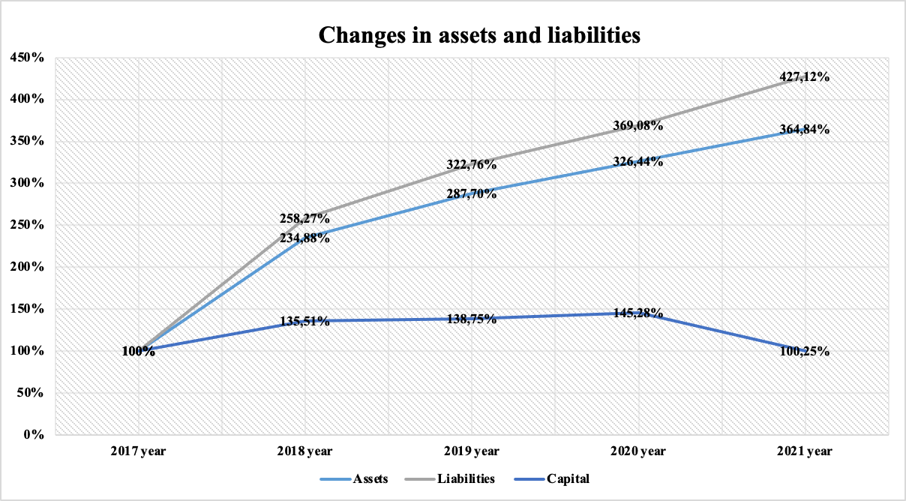
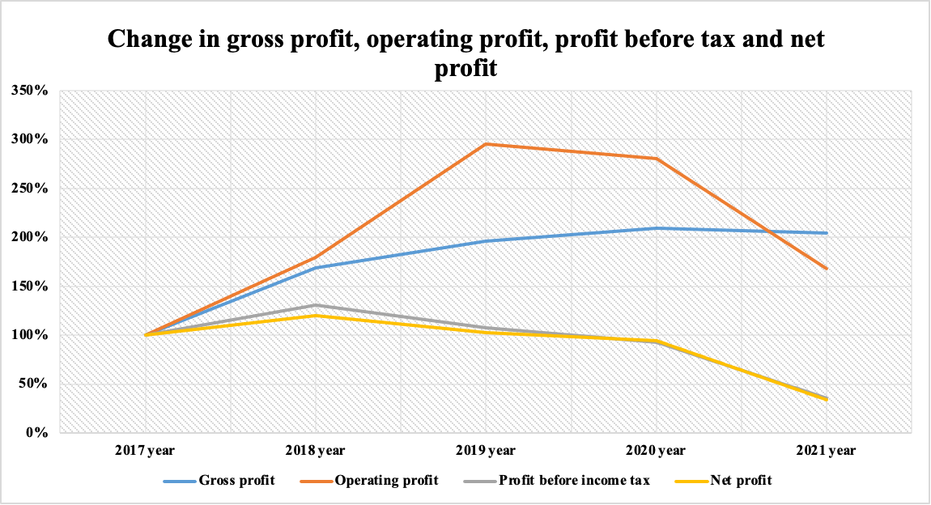
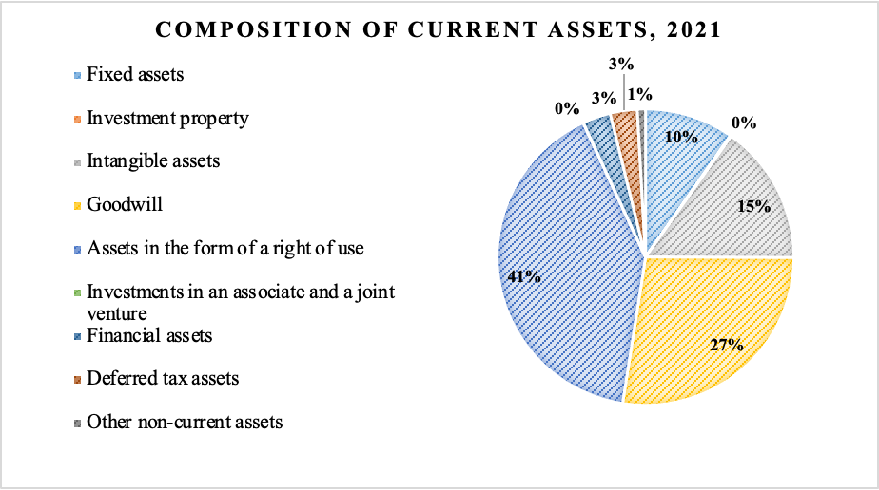
Vertical analysis
Horizontal analysis

Slide 6
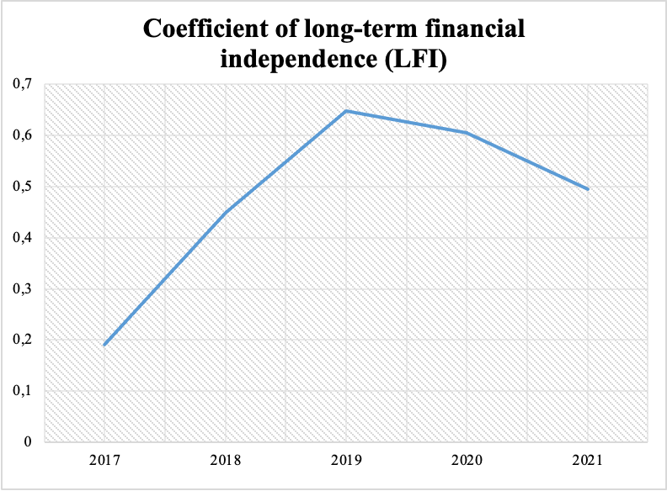
The coefficient of long-term financial independence (LFI) shows what part of the total value of the company's assets is formed from the most reliable sources of financing, that is, it does not depend on short-term borrowed funds.
In essence, this is a refined coefficient of autonomy. If the company's liabilities include long-term liabilities, it is advisable to use this coefficient instead of the autonomy coefficient. One of the recommended values of this coefficient is 0.9, the critical value is 0.75.
According to the conditions of our example, the CFLF for the analyzed period increases from 0.19 in 2017 to 0.5 in 2021, which reflects a decrease in the company's dependence on short-term borrowings.

Slide 7
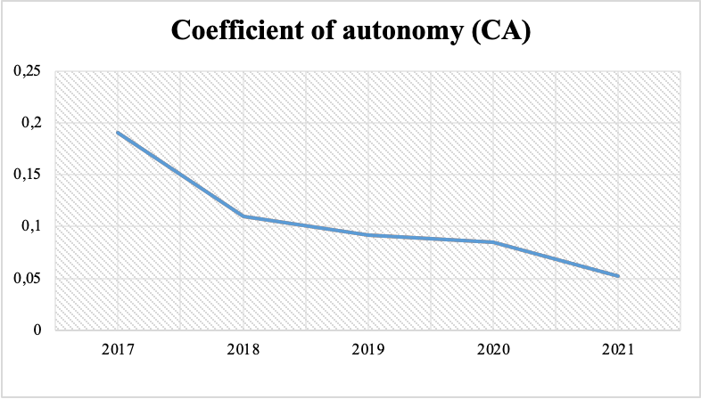
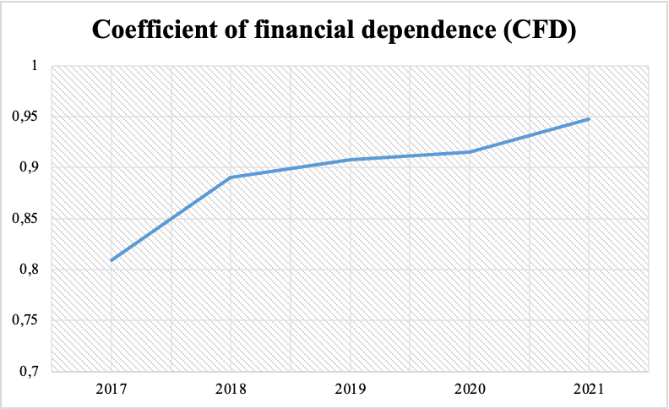
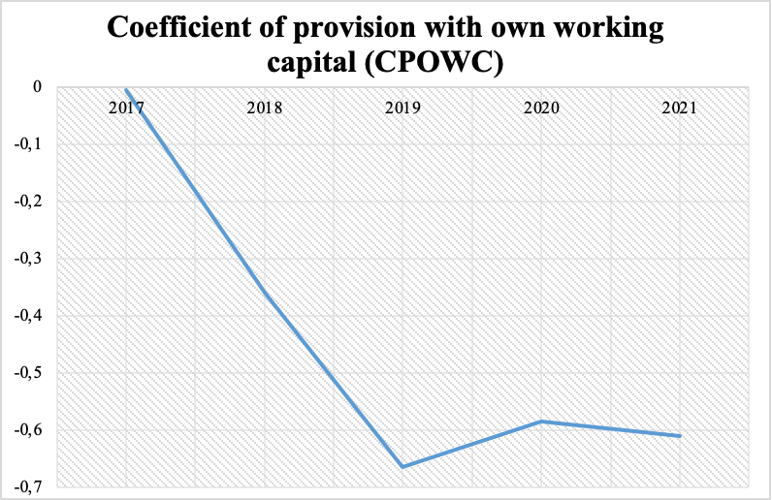
Ratio analysis

Slide 8
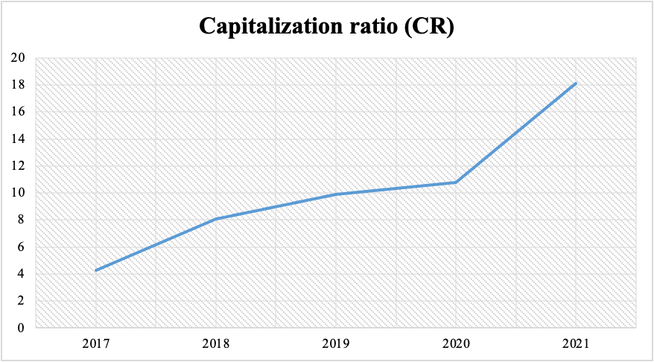
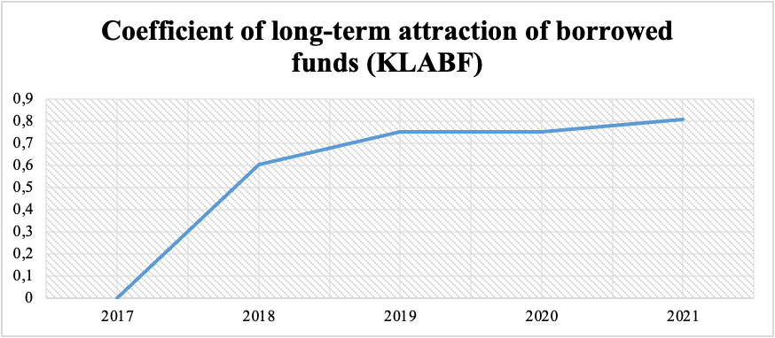
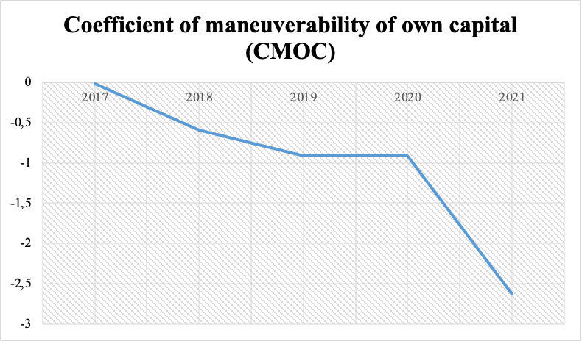
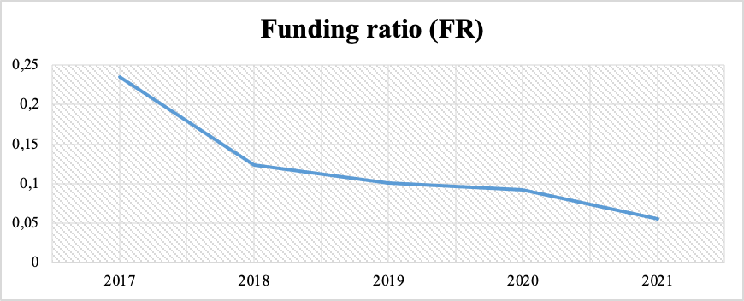
Ratio analysis

Slide 9
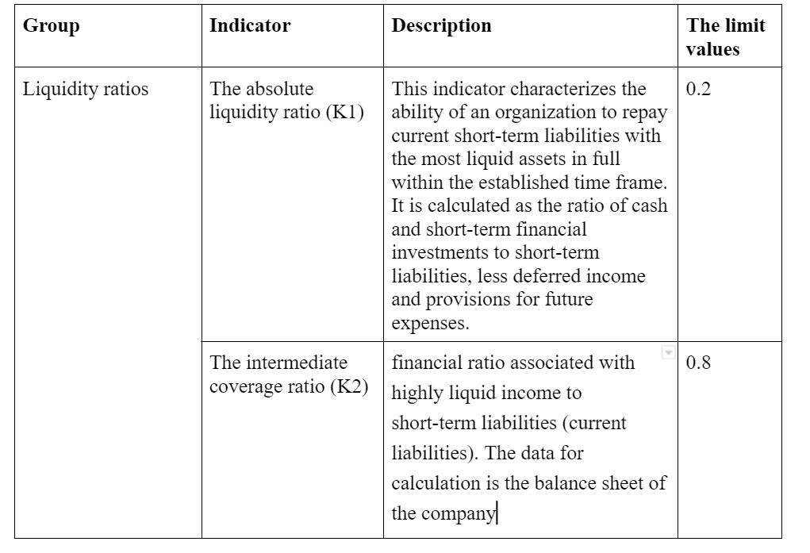
Creditworthiness analysis
We used the method of analyzing the creditworthiness of the enterprise according to the method of Sberbank of the Russian Federation.

Slide 10
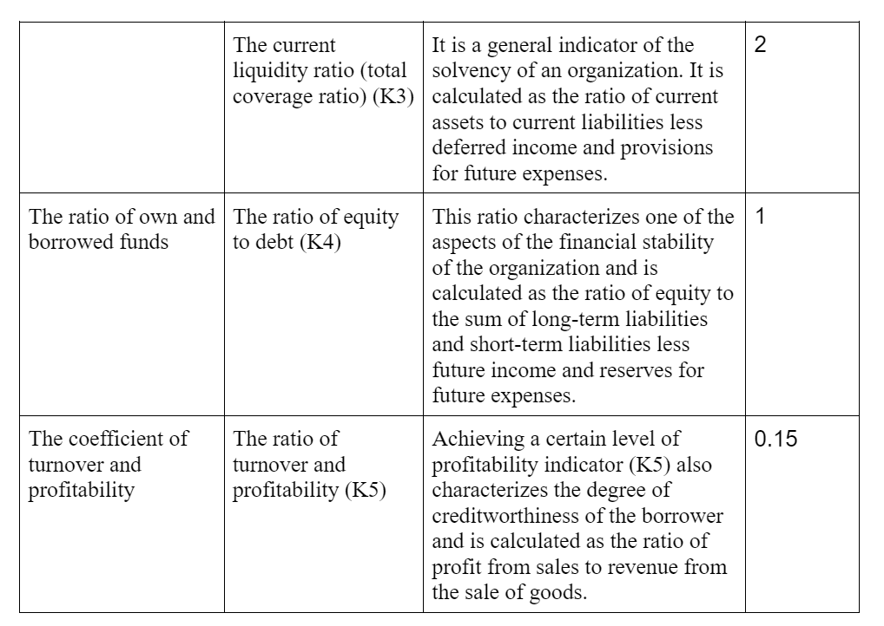

Slide 11
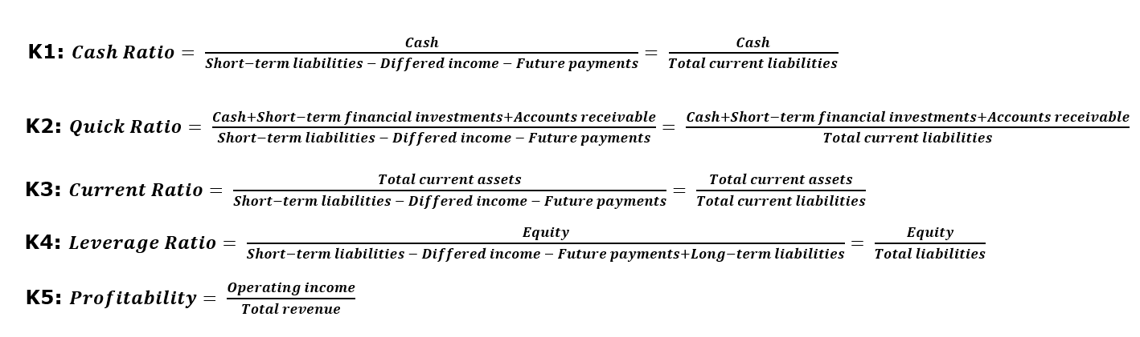

Slide 12
Creditworthiness analysis
Each of the indicators in the table is calculated. Further, the calculated indicators are summed up in accordance with their weights. At the last stage, the borrower is assigned a rating or class that determines its creditworthiness.
 | 2018 | 2019 | 2020 | 2021
Cash Ratio K1 | 45291 | 45291 | 45291 | 45291
Cash Ratio K1 | 0,39 | 0,27 | 0,18 | 0,21
Quick Ratio K2 | 0,46 | 0,35 | 0,27 | 0,30
Current Ratio K3 | 0,99 | 0,91 | 0,87 | 0,88
Leverage Ratio K4 | 0,24 | 0,12 | 0,10 | 0,09
Profitability K5 | 0,04 | 0,05 | 0,07 | 0,05

Slide 13
Creditworthiness analysis
We determine the class of borrower as third class, which means that this lending to the enterprise is associated with increased risk.
Coefficients | 2018 | 2019 | 2020 | 2021
0,11 | 1 | 1 | 2 | 1
0,05 | 3 | 3 | 3 | 3
0,42 | 3 | 3 | 3 | 3
0,21 | 3 | 3 | 3 | 3
0,21 | 3 | 3 | 3 | 3
S | 2,78 | 2,78 | 2,89 | 2,78
Class | 3rd CLASS | 3rd CLASS | 3rd CLASS | 3rd CLASS

